Slide 1


Whatever your challenges, we’ll be there for you.
Because when you’ve got Unum…
ADR1952-2019
Notes:
Today we’ll talk about….

Slide 2


Unum Benefits at Wesleyan University
Disability Insurance
Employer paid Short- and Long-Term
Disability
Term Life Insurance
Employer paid Base and Optional Buy-up
Life
Travel Assistance Program
Notes:
Today we’ll talk about….

Slide 3

What is Disability Insurance?
Your employer provides your Disability insurance
There is no cost to you for this coverage
Benefits begin after satisfying your elimination period
Short term disability up to 26 weeks
Long term disability begins after 26 weeks
Short term coverage dovetails into Long term coverage

Slide 4

Connecticut Paid Leave
As a covered employee in the State of Connecticut, the Connecticut Paid Leave (CT PL) program allows you to take time off to care for yourself and your family’s health needs without worrying about loss of income while you are away from work.
Eligibility:
Must be an active employee, have either earned wages of at least $2,325 over the qualifying period or have been employed within the last twelve months.
Benefit:
Twelve weeks if you or a family member have experienced a serious health condition, are welcoming a new child into your family, are impacted by family violence, need to care of a family member injured while on active duty in the military or to take leave to prepare for a family member entering the active military overseas.
Two additional weeks are available if you experience a serious health condition during pregnancy.
Notes:
These next few slides cover the new CT Paid Leave benefit. The most important thing you need to know about this benefit is that it will affect how benefits will be paid to you by Wesleyan for both short term disability and parental leave. This is because, in most cases, the majority of these benefits will now be paid to you by the State of Connecticut through their selected administrator AFLAC.
Review eligibility and benefit as per slide.

Slide 5
Short-Term Disability (STD)
Wesleyan provides short-term disability (STD) insurance to all benefit-eligible employees at no cost. STD insurance is designed to help you meet your financial needs if you become unable to work due to a non-work related illness or injury. The length of short-term disability will be determined by Wesleyan’s STD insurance provider (Unum) but can be no longer than six months.
Please refer to Wesleyan’s Staff Handbook for plan details including what your income replacement coverage level is based on your years of service and employee group.
Please note: Wesleyan’s short term disability program supplements CT Paid Leave, your total coverage between the two programs will provide the income replacement outlined in the Handbook.

Slide 6
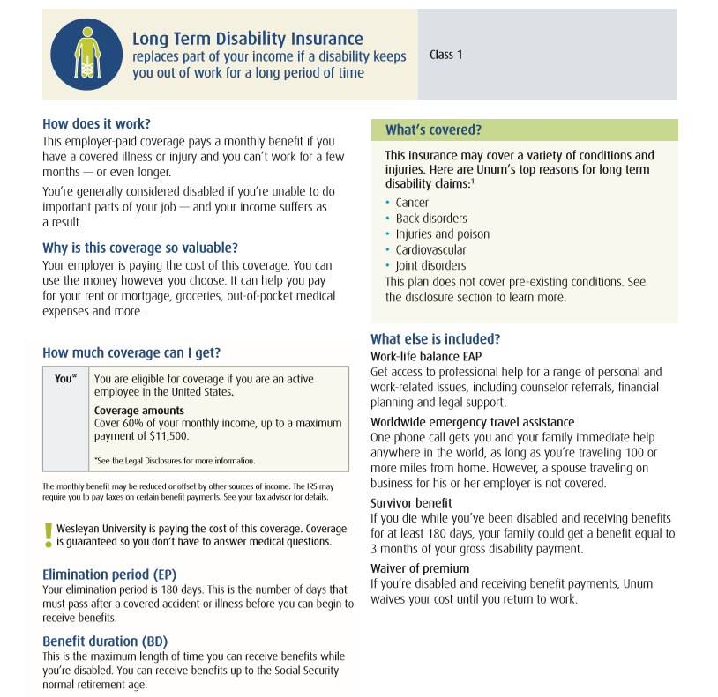
Notes:
When it comes to understanding the experiences our clients and their employees are having, we go straight to the source.
We keep it simple, asking our clients and their employees to let us know how they felt about their experience, and we constantly adjust based on their feedback. If we miss the mark, they hear from us so we can make it right and figure out how to make sure we get it exactly right the next time.
In all that we do, we free up our clients to focus on their businesses and the people who make it strong. The more we push to make these experiences the very best in our industry, the less our clients have to think about Unum.
And that’s a good thing.

Slide 7
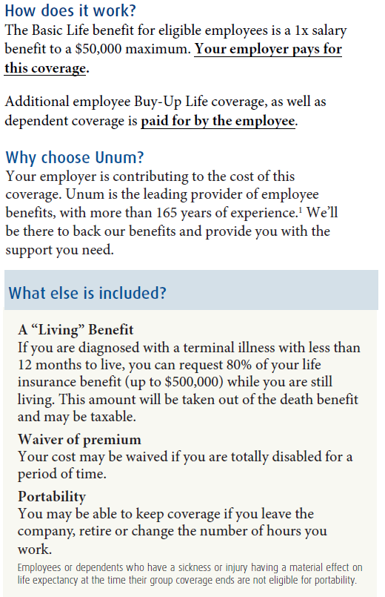
Unum Term Life Insurance at Wesleyan University
supplemental coverage, as well as
You may keep this coverage if you change employers.
This coverage includes Accelerated Benefits.
You can purchase additional life insurance.
You can purchase life insurance for a spouse/domestic partner.
You can purchase life insurance for dependents.
Notes:
We’ve expanded our robust benefits portfolio to included dental, vision and stop loss. Across the board, we’ve got you covered

Slide 8
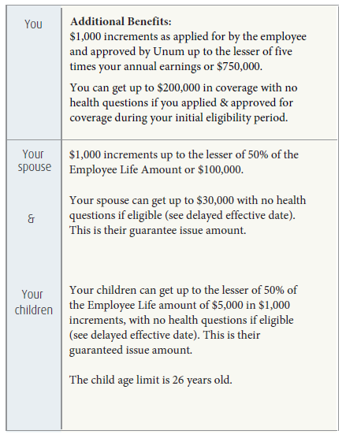
Unum Term Life Insurance Continued…
Full-time employees who are actively at work may apply for supplemental coverage
You may purchase additional Life coverage in increments of $1,000 to a maximum of 5x your earnings or $750,000.
The Supplemental Life non-medical maximum is $200,000
Notes:
We’ve expanded our robust benefits portfolio to included dental, vision and stop loss. Across the board, we’ve got you covered

Slide 9

Worldwide Travel Assistance
When things happen, we can lend a helping hand
Help with finding access to qualified medical providers.
Emergency medical evacuation.
Assistance for missing passports, lost credit cards and stolen cash
Covers any member of the family when traveling 100 miles or more from home.¹
“My wallet was stolen while I was driving my daughter to college in another state. My travel assist coverage helped get replacement credit cards overnighted to our hotel, so she wouldn’t miss orientation.”*
1 Spouses traveling on business for their employers are not eligible.
* For illustrative purposes only.

Slide 10
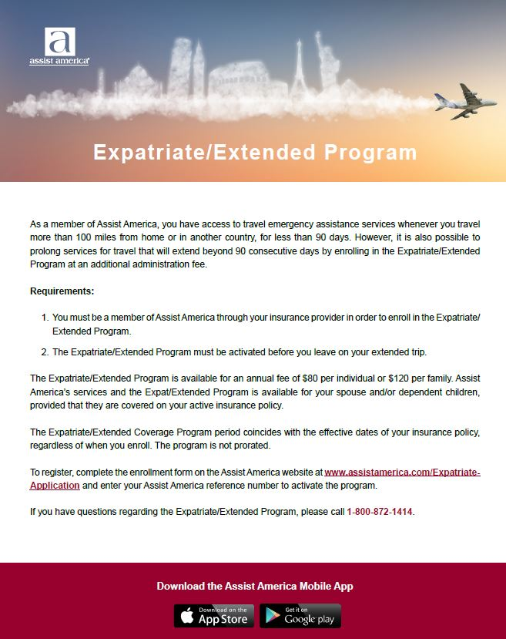

Slide 11


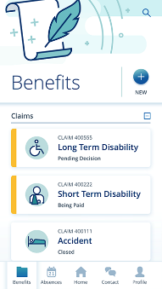
Simple and efficient ways for employees
to connect.
Employee Portal + Mobile App
Submit a claim
View claim status and updates
Update personal information
Check payment status and history
Initiate direct deposit
Send letters and documents to Unum
Submit outstanding information
Review correspondence
Provide authorization
Telephone
Unum Contact Center available Monday through Friday 8 a.m. – 8 p.m.
Empathetic and knowledgeable specialists available to initiate a claim, answer policy or claims questions
Direct line to benefit specialists
Notes:
Today we’ll talk about….

Slide 12

Thank you!
Questions?
Because when you’ve got Unum…
Notes:
Welcome and introductions.

